Slide 1
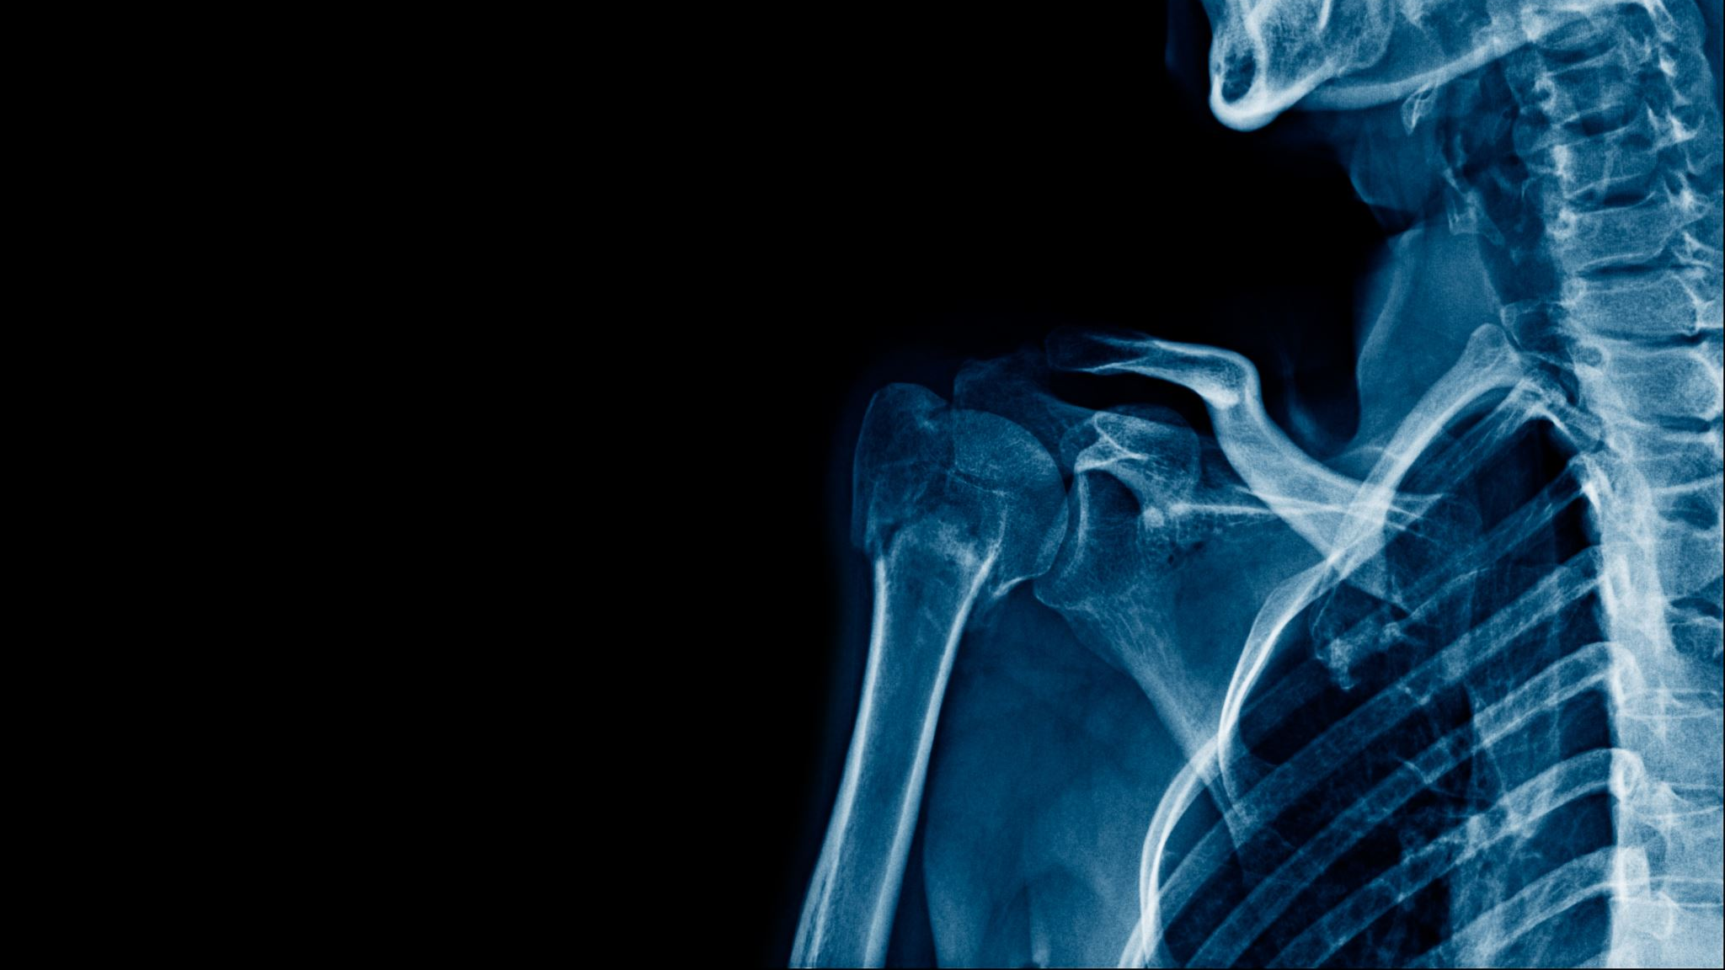
Medical X-Ray Classification – Normal vs. Pneumonia
Team Members: Spandana Dammanagari
Sunaina Makkena

Slide 2
Table Of Contents
Problem Statement
Dataset Description
Pre-processing
Model Architecture
Training Setup(Hyperparameters)
Result and Evaluation Metrics
Discussion & Analysis
Challenges
Future Work
Conclusion
References

Slide 3
Problem Statement
Pneumonia is a common yet serious lung infection requiring early diagnosis.
Manual X-ray interpretation is time-consuming and prone to human error.
This project aims to build an automated classification system that identifies whether a chest X-ray is Normal or Pneumonia.
The goal is to improve diagnostic assistance and support medical professionals.

Slide 4
Dataset Description
Dataset Name: Chest X-Ray Images (Pneumonia) – Kaggle Dataset
Total Images: ~5,863 chest X-rays
1. Normal: 1,583 images
2. Pneumonia: 4,273 images
Image Type: Grayscale/Single-channel X-ray images
Format: JPEG
Split:
Train: 80%
Validation: 10%
Test: 10%
Challenges: Class imbalance (Pneumonia > Normal)

Slide 5
Pre-processing
Image resizing to 224 × 224 for consistency
Normalization of pixel values to [0,1]
Data augmentation applied to reduce overfitting:
1. Rotation
2. Horizontal flip
3. Zoom
4. Width/height shift
Converted all images into batches for efficient training
Ensured balanced sampling during training

Slide 6
Model Architecture
Base Model: Pretrained ResNet-50 (Transfer Learning)
Why ResNet-50?
  Deep architecture with skip connections
  Excellent performance on medical and grayscale images
  Reduces vanishing gradient issues
Custom Layers Added:
  Global Average Pooling
  Dense Layer (256 units, ReLU)
  Dropout (0.3)
  Output Layer: Dense(1, Sigmoid) for binary classification
Total Trainable Parameters: ~23M (after freezing initial layers)

Slide 7
Training Setup (Hyperparameters)
Loss Function: Binary Cross-Entropy
Optimizer: Adam
Initial Learning Rate: 0.0001
Batch Size: 32
Epochs: 10–20
Callbacks Used:
1. Early Stopping (avoid overfitting)
2. Model Checkpoint (save best model)
3. ReduceLROnPlateau (adaptive LR scheduling)

Slide 8
Results & Evaluation Metrics
Accuracy: ~94–96%
Precision: High — model avoids false positives
Recall: High — model detects pneumonia effectively
F1-Score: Balanced performance
Validation Accuracy: Stable with no major overfitting signs
Test Accuracy: ~94%

Slide 9
Discussion & Analysis
The model successfully learned discriminative lung patterns.
Transfer Learning significantly improved performance with fewer training images.
Augmentation reduced overfitting and improved generalization.
The main difficulty is handling borderline/mild pneumonia images.
Dataset imbalance affects precision on minority class (Normal).

Slide 10
Challenges
Class imbalance (Normal < Pneumonia)
Variations in X-ray contrast, lighting, and intensity
Limited dataset size for Normal images
Risk of overfitting due to high model capacity
Some X-rays are noisy or poorly exposed

Slide 11
Future Work
rain on larger and more balanced medical datasets
Use advanced models like EfficientNet-B3 or Vision Transformers
Apply Grad-CAM for heatmap explanation
Deploy as a web app for real-time X-ray classification
Improve handling of mild pneumonia cases

Slide 12
Conclusion
Successfully built an accurate deep learning model for medical X-ray classification.
Achieved ~94–96% accuracy using ResNet-50 + Transfer Learning.
The system can assist radiologists by providing fast, reliable predictions.
Further improvements can make it clinically usable.

Slide 13
References
Deng et al., “ImageNet: A Large-Scale Hierarchical Image Database”
Rajpurkar et al., “CheXNet: Radiologist-Level Pneumonia Detection on Chest X-rays”
Kaggle Pneumonia Chest X-ray Dataset
Keras Applications: ResNet-50 Documentation
Any textbook or course notes used

Slide 14

.
Thank You

